Slide 1
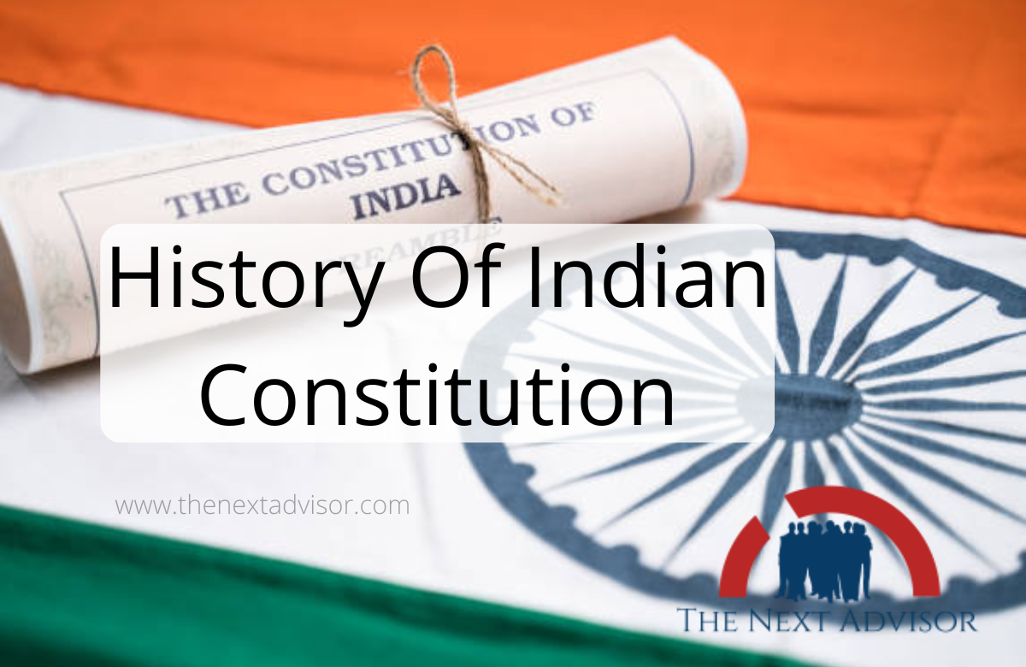

Slide 2
Professor & Lawyer
Puttu Guru Prasad
B.Com., M.Com., M.Phil., M.B.A., PGDFTM., AP.SET., M.Phil., DRMS., L.L.B.,
ICFAI TMF., DIRM., L.L.M., Pre PhD (PhD)from JNTUK., Topper
Domain Topper & 30th Batch Topper at ICFAI -2009 (TMF) (TMF) Training for Management Faculty
LL.M Degree from ANU with First Class & Distinction
“Diploma in Psychology from YALE University”
MHRDI’s 'Institution's Innovation Council (IICs)Ambassador
NSS Certified Program Officer, (A.U)
LL.B Degree Gold Medallist from ANU-2005
ICFAI UNIVERSITY Trained Senior MBA Faculty
Eminent Faculty for Accounts, Business Studies, Economics,
Head, Board of Administration & Management Science,
BHAGAVAD GITA & CLAT & IPMAT Program Coordinator,
Commerce Department, VIVA-VVIT, Nambur,
My Blog: puttuguru.blogspot.in My Web Site: https://gurublogs.wixsite.com/guru
93 94 96 98 98, 9885 96 36 36, 807 444 9539,

Slide 3
Constitutional Development of India
The origin and growth of the Indian Constitution have its roots in Indian history during the British period.
From 1773 onwards, various Acts were passed by the British Government for the governance of India.
None of them, however, satisfied Indian aspirations mainly because they were imposed by the alien rulers.
The period of historical British Constitutional experiments in India can be divided into two phases:
1. Phase 1- Constitutional experiment during the rule of the East India Company (1773-1857)
2. Phase 2 – Constitutional experiments under the British Crown (1857-1947)

Slide 4
Constitutional Development – East India Company Rule (1773 – 1857)
From 1757 to 1857, 5 major laws were created to regulate the functioning of British East India Company and to help them rule over India. The details of these 5 Acts are mentioned below.
Regulating Act of 1773
The process of Centralization in India was initiated through the Regulating Act of 1773.
1. This is the first Act passed by the British Parliament to control and regulate the affairs of the East India Company in India.
2. As per this Act, the Governor of Bengal was made the Governor-General.
3. Warren Hastings was the first Governor-General of India.
4. This Act made Governors of Bombay and Madras subordinate to the Governor of Bengal.
5. The Governor-General was given the power to make rules and regulations.
6. The Governor-General was assisted by a Council of 4 members.
7. The number of Directors in the Company was fixed at 4.
8. The Governor-General had to follow the orders of the Directors of the Company.
9. Revenue of the company should be reported by The Court of Directors, who were the governing body of the company
10. A Supreme Court was established at Calcutta in 1774, as per the provisions of Regulating Act 1773.
11. The Supreme Court had a Chief Justice and 3 Assistant Judges.

Slide 5
Pitts India Act of 1784
In the Constitutional history of India, this Act brought in many significant changes.
1. As per this Act of 1784, the territories of East India Company was called as the “British Possessions in India”
2. As per this Act, a joint Government of British India run by the Crown and Company was established. The government had the ultimate power and authority.
3. A Court of Directors was formed for Commercial Operations and 6 member Board of Control were appointed for Political affairs as per provisions of Pitts India Act 1784.
4. Governor General’s Council was reduced from 4 members to 3 members.
5. Governors Councils were established in Bombay and Madras.

Slide 6
Charter Act of 1813
1. It brought an end to the monopoly of East India Company, over trade with India.
2. Trade with India was opened for all British Citizens with the exception of Tea Trade.
Charter Act of 1833
1. Governor-General of Bengal became the Governor-General of India.
2. Lord William Bentick was the 1st Governor-General of India.
3. East India Company ended as a mere administrative body, it was no longer a commercial body.
4. The Governor-General was given full control over revenue, civil and military.
5. Charter Act of 1833 was the final step in the Process of Centralization in India, a process that began with the Regulating Act of 1773.
Charter Act of 1853
1. Civil Service Examination was introduced. It was a competitive examination for recruitment into the civil services.
2. Executive and Legislative functions of the Governor-General were separated.
3. This Act provided for the addition of 6 new members to the Legislative Council, 4 members were appointed by Provisional Governments of Bengal, Bombay, Madras and Agra.
4. As per provisions of Charter Act of 1853 Governor General’s Legislative Council came to be known as the Central Legislative Council.
5. The Central Legislative Council started functioning as a Mini-Parliament. It adopted the same procedures of the British Parliament.

Slide 7
Constitutional Development – Rule under the British Crown (1857-1947)
Government of India Act of 1858
1. Government of India Act of 1858 passed by British Parliament, brought an end to the rule of East India Company. The powers were transferred to the British Crown.
2. The Secretary of State for India was given the powers and duties of the former Court of Directors. He Controlled the Indian Administration through the Viceroy of India.
3. The Secretary of State for India was assisted by the Council of India. This Council had 15 members. The Council was an advisory body.
4. Governor-General of India was made the Viceroy of India.
5. Lord Canning was the 1st Viceroy of India.

Slide 8
Indian Council Act of 1861 Indian Council Act of 1892.
1. Indians were nominated as non-official members for the 1st time in the Legislative Council of Viceroy.
2. Legislative Councils were established in Provinces and Centre.
3. Legislative powers of the Provinces of Bombay and Madras were restored.
4. Legislative Councils were started in the Provinces of Punjab, North-Western Frontier Province (NWFP), Bengal.
1. The size of the Legislative Council was increased.
2. The Legislative Council was given more power, they had the power to deliberate on the Budget and could pose questions to the Executive.
3. Indirect elections were introduced for the 1st time.
4. The Principal of Representation was introduced as per provisions given in the Indian Councils Act, 1909 – Morley Minto Reforms
1. Indian Councils Act of 1909 is commonly known as Morley Minto Reforms.
2. For the 1st time, Direct elections were introduced for the Legislative Councils.
3. The Central Legislative Council was renamed as the Imperial Legislative Council.
4. The Communal representation system was introduced by giving separate electorate. It was a system where seats were reserved only for Muslims and only Muslims would be polled.
5. For the first time, Indians were appointed to the Executive Council of Viceroy. Satyendra Sinha was the law member.

Slide 9
Government of India Act, 1919 – Montagu Chelmsford Reforms
1. Government of India Act, 1919 was also known as the Montagu Chelmsford reforms.
2. Bicameralism was introduced for the 1st time.
3. Provincial and Central Subjects were separated.
4. Dyarchy, a scheme of Dual Governance was introduced in the Provincial Subjects, it was divided into Reserved and Transferred. The transferred list included agriculture, health, education, and supervision of the local government. The Transferred list was given to the Government of Ministers answerable to the Provincial Council. The reserved list included communications, foreign affairs, and defense; this transferred list was under the control of the Viceroy.
5. Out of 6 members in the Viceroy’s Executive Council, 3 of them were Indians.
6. The Act provided provisions for the establishment of the Public Service Commission in India for the first time.
7. Communal Representation extended to Christians, Anglo-Indians, and Sikhs.
8. The franchise was given to a limited population which was based on people who had taxable income, had property, and paid land revenue of Rs 3000.
9. Montagu Chelmsford Reforms made provision for setting up a statutory commission at the end of 10 years to look into the working of the Government.

Slide 10

Professor & Lawyer
Puttu Guru Prasad

